Slide 1
Final Report of the Capstone Project – The Battle of Neighborhoods Finding a Better Place in Brooklyn, NY

Slide 2
Introduction
This project will help people to better explore facilities around their neighborhood. It will help people making smart and efficient decision on selecting great neighborhood out of numbers of other neighborhoods in Brooklyn, New York. The project will compare various location and venues around each of the neighborhoods like cafes, schools, super markets, medical stores, shopping centers, theatres, hospitals, etc. This project aims to create an analysis of features for people wishing to move to Brooklyn to search for the best neighborhood as a comparative analysis between neighborhoods. An additional feature is included as comparison which is average rent. It will help people to get awareness of the area and neighborhood before moving to a new city, state, country or place for their work or to start a new fresh life.

Slide 3
Data
For this project we wil be using data available in the New York week 3 assignment. Link: https://geo.nyu.edu/catalog/nyu_2451_34572
Also we will be using data of average rent from this link :https://www.rentcafe.com/average-rent-market-trends/us/ny/brooklyn/

Slide 4
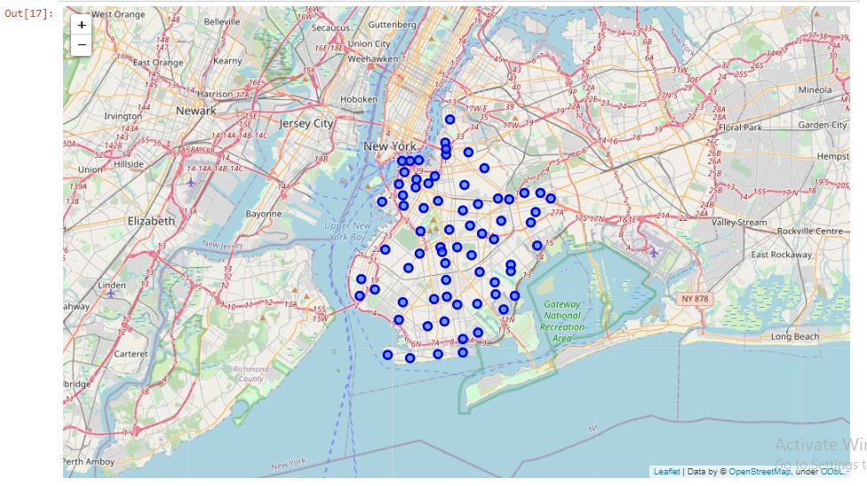
Map of Brooklyn

Slide 5
Methodology Section
Clustering Approach:
To compare the similarities of two cities, we decided to explore neighborhoods, segment them, and group them into clusters to find similar neighborhoods in a big city like New York and Toronto. To be able to do that, we need to cluster data which is a form of unsupervised machine learning: k-means clustering algorithm.

Slide 6
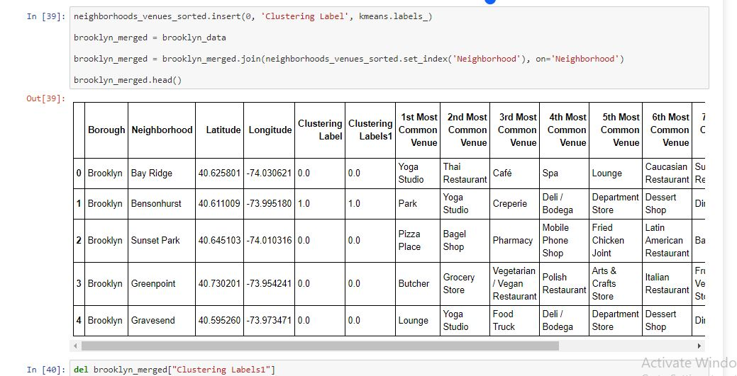
Using K-Means Clustering Approach

Slide 7
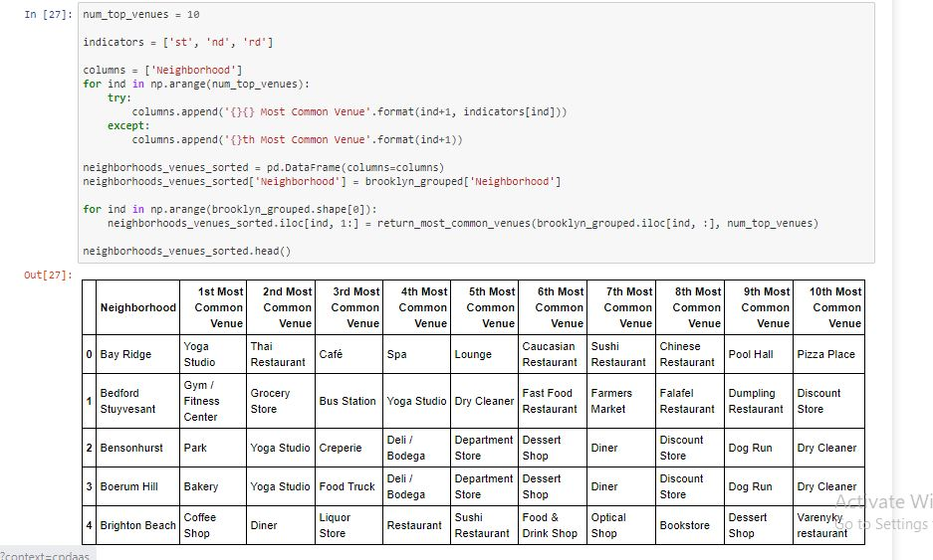
Most Common venues near Neighborhood

Slide 8
Results Section

Slide 9
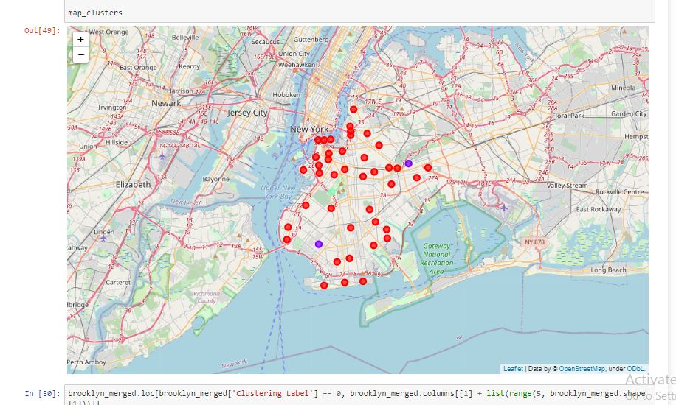
Map of Clusters in Brooklyn

Slide 10
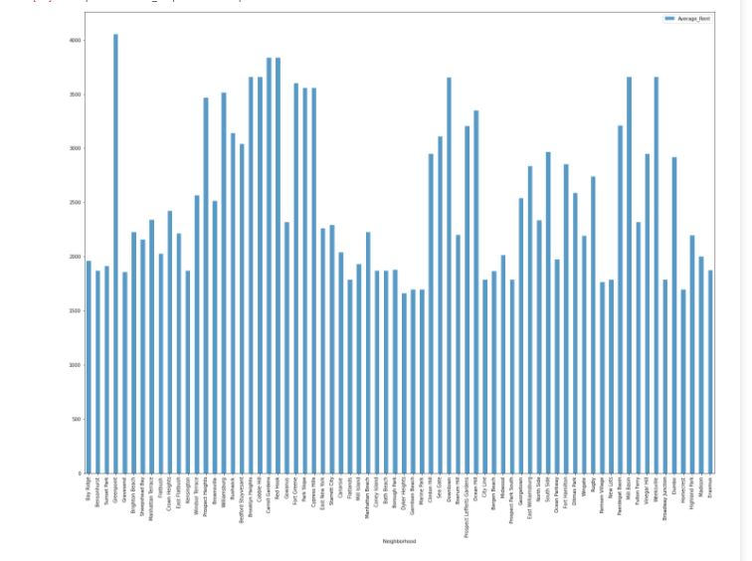
Average Rent by Clusters in Brooklyn

Slide 11
Discussion Section
Problem Which We Tried to Solve
The major purpose of this project, is to suggest a better neighborhood in a new city for the person who will be moving there. Social presence in society in terms of likeminded people. Connectivity to the airport, bus stand, city center, markets and other daily needs things nearby. Sorted list of house in terms of average rent prices.

Slide 12
Conclusion
In this project, using k-means cluster algorithm I separated the neighborhood into 3 different clusters and for 128 different latitude and longitude from dataset, which have very-similar neighborhoods around them. Using the charts above results presented to a particular neighborhood based on average house prices and school rating have been made.
I feel rewarded with the efforts and believe this course with all the topics covered is well worthy of appreciation. This project has shown me a practical application to resolve a real situation that has impacting personal and financial impact using Data Science tools. The mapping with Folium is a very powerful technique to consolidate information and make the analysis and decision better with confidence.

Slide 13
Future Work:
This project can be continued for making it more precise in terms to find best house in Scarborough. Best means on the basis of all required things (daily needs or things we need to live a better life) around and also in terms of cost effective.

Slide 14
Libraries which were used to develop the Project:
Pandas: For creating and manipulating data frames.
Folium: Python visualization library would be used to visualize the neighborhoods cluster distribution of using interactive leaflet map.
Scikit Learn: For importing k-means clustering.
JSON: Library to handle JSON files.
XML: To separate data from presentation and XML stores data in plain text format.
Geocoder: To retrieve Location Data.
Beautiful Soup and Requests: To scrap and library to handle http requests.
Matplotlib: Python Plotting Module.

